Slide 1
When statistical areas lie: Better maps with R
Henry McMillan
Manpreet Singh
Notes:
Spatial data adds new dimensions presentation of economic data
Geographic clustering
Tangible and recognisable audiences
Extensive web map services
Todays presentation: implementation and design

Slide 2
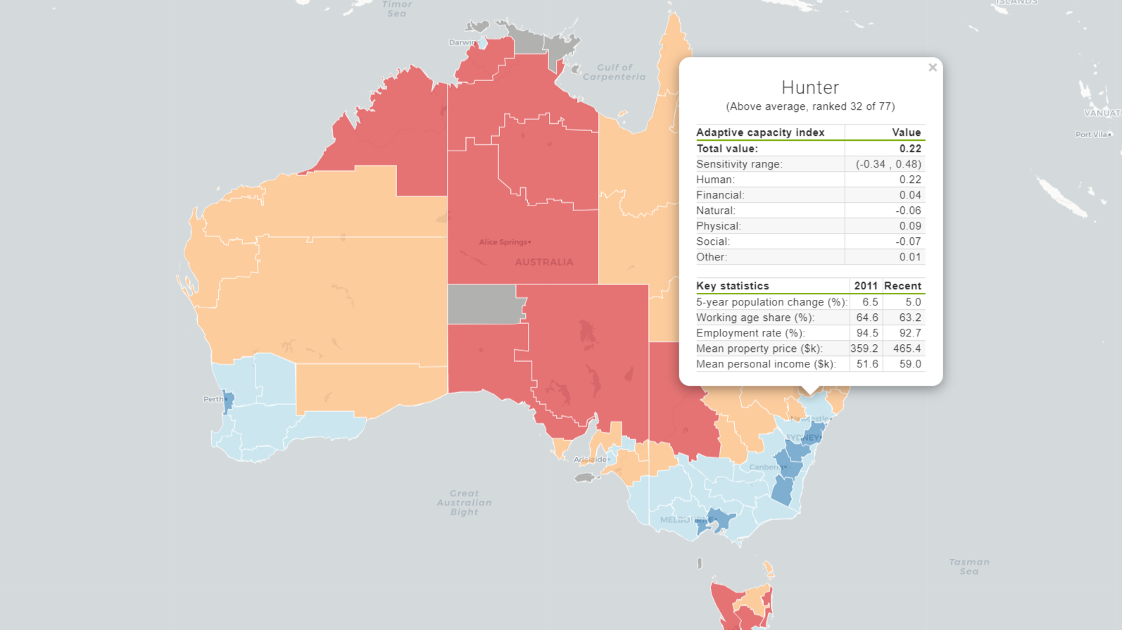
Better maps with R

Slide 3
WRONG
Better maps with R

Slide 4
Land ≠ people
Better maps with R

Slide 5

Better maps with R

Slide 6
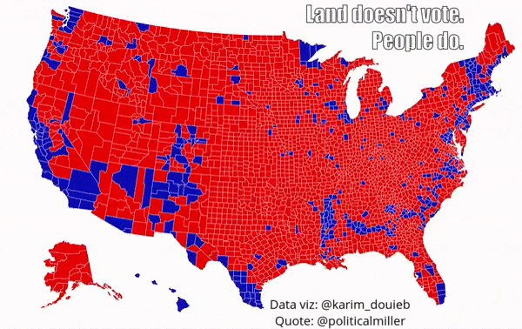
Better maps with R

Slide 7
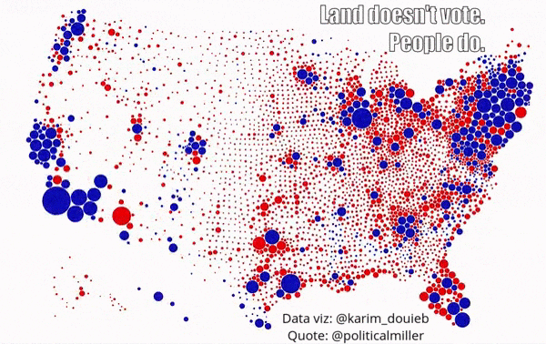
Better maps with R

Slide 8
Today’s masterclass
Objective
Produce publication ready & unbiased maps using ABS Socio-Economic Indexes for Areas
Better maps with R
Notes:
Each topic covered in an activity.

Slide 9
Today’s masterclass
Good map design
Parsing data and basic maps
Wrangling spatial data
Representing population
Communication
Better maps with R
Notes:
Each topic covered in an activity.

Slide 10
Learning platform
Rstudio server
Unique login slips
Each activity is an R script
Better maps with R
Notes:
Each activity will build on each other – don’t fret if you don’t finish one before we progress to the next activity. Use the answers in the R scripts provided to you.

Slide 11

What is spatial data?
Notes:
Spatial or geospatial data is the data that identifies the geographic location of features and boundaries on Earth.

Slide 12
Types of spatial data
Point
Line
Polygon
Raster
Introducing spatial data
Notes:
Point: Locations are points, described by a single pair of coordinates.
Line: Data associated with a collection of points connected by a line. E.g. streams
Polygon: Data associated with points in an enclosed area e.g. Farm fields
Raster: Grid data. Data associated with every cell in the grid. E.g. Satellite imaging of the earth

Slide 13
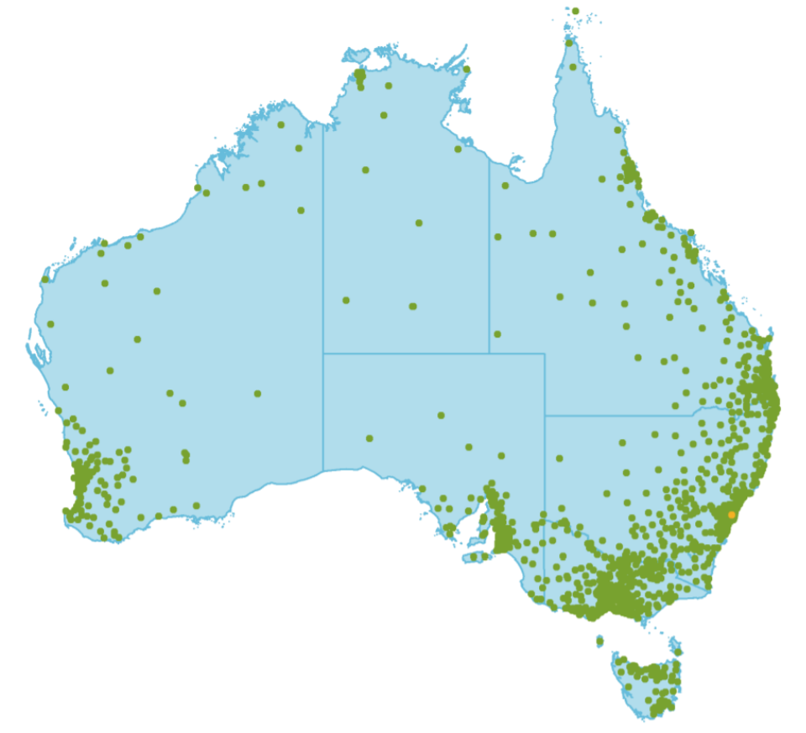
Examples: Point Mental Health – Location of people seeking online treatment for mental health
Introducing spatial data
Notes:
Postcode locations of MindSpot (a clinician-supported online mental health treatment service) consumer 2018 (MindSpot located in Macquarie Uni in Sydney – yellow dot).
Ref: Figure 6.1 Volume 1.

Slide 14
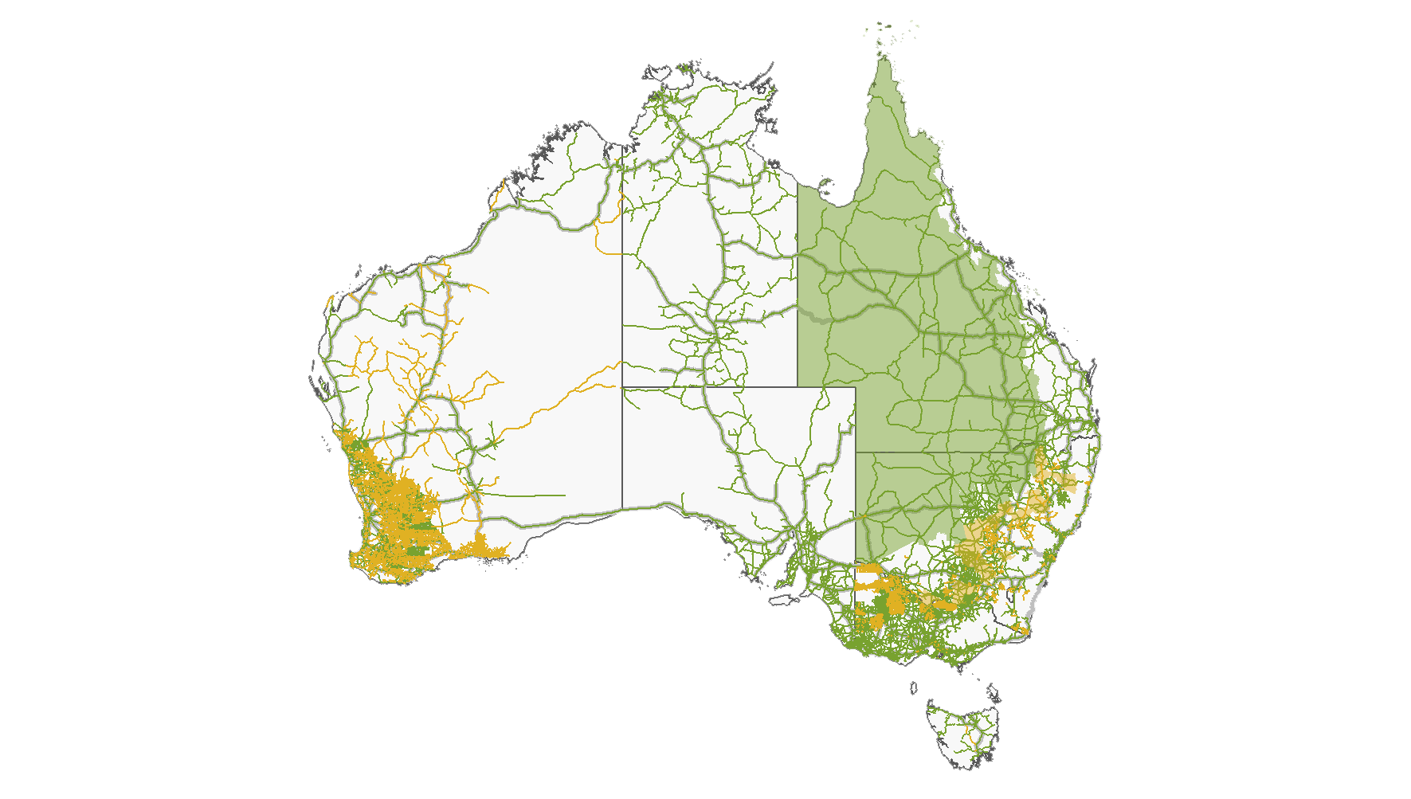
Line + polygon National Transport Regulatory Reform - Heavy vehicle road access networks
Introducing spatial data
Notes:
Lines are approved roads, and polygons are approved areas for B double road trains in Australia.
Ref: Figure 6.9

Slide 15


Coordinate Reference Systems in R
How coordinates relate to physical locations.
CRS has various attributes:
Ellipses
Datum: defines the origin and orientation of coordinate axis on the ellipsoid
Projection
Introducing spatial data
Notes:
The distinguishing feature of spatial data is that it represents actual locations on Earth. To represent the geographic placement of an object you need two pieces of information: the coordinates of the object and a system of reference for how the coordinates relate to a physical location on Earth. Enter CRS.
The objective of the CRS is to take a 3D ellipse, which describes the shape of the earth (such as a globe) and project that onto a 2D surface such as a paper map or a computer screen.
Most commonly used CRSs have unique IDs called EPSG (European Petroleum Survey Group) codes to identify them.
Ellipses: describes shape of the earth (e.g. a globe).
Datum: defines an origin and orientation of the coordinate axis. The simplest datums are a spheroid (a sphere that is ‘flattened’ at the poles and bulges at the equator). More complex datums allow for more variation in the earth’s shape. The most commonly used datum is called WGS84 (World Geodetic System 1984). This is very similar to NAD83 (The North American Datum of 1983). Other, local datums exist to more precisely record locations for a single country or region.
Projection: transforms a 3D ellipse on to a 2D surface (e.g. a map)
Most commonly used CRSs have unique IDs called EPSG (European Petroleum Survey Group) codes to identify them. WSG84, NAD83 CRSs have unique EPSG codes.
In R we use the PROJ.4 - an open source software library that is commonly used for CRS transformation.
CRS can be transformed from one to another
Package to assign and transform CRS: sp and rgdal

Slide 16
Simple features package
State | Date | GSP | Geom
NSW | 2019-06-30 | 548457 | MULTIPOLYGON(((-81.5…
VIC | 2019-06-30 | 430153 | MULTIPOLYGON(((-82.1…
QLD | 2019-06-30 | 400531 | MULTIPOLYGON(((-80.2…
WA | 2019-06-30 | 322670 | MULTIPOLYGON(((-80.1…
SA | 2019-06-30 | 122302 | MULTIPOLYGON(((-82.1…
Normal data frame
New geometry column
Introducing spatial data
Notes:
We use simple features package, which contains both:
attributes to describe the object, such as a name, values, colour, etc., which is the data in the blue shading on the left – your usual data frame – and
geometry (lat/long, points etc. and CRS) to identify its location on Earth (which is the data in green on the right stored under the ‘geometry’ column). This is the only additional bit of data, making it easy and intuitive to use.

Slide 17




Where to find spatial data
Data.gov.au
ABS
Google Maps
Stamen Maps
Introducing spatial data
Notes:
ABS: ASGS Cat. no. 1270.0.55.001: shapefiles and data by statistical areas
get_maps and ggmap: use Google or Stamen

Slide 18
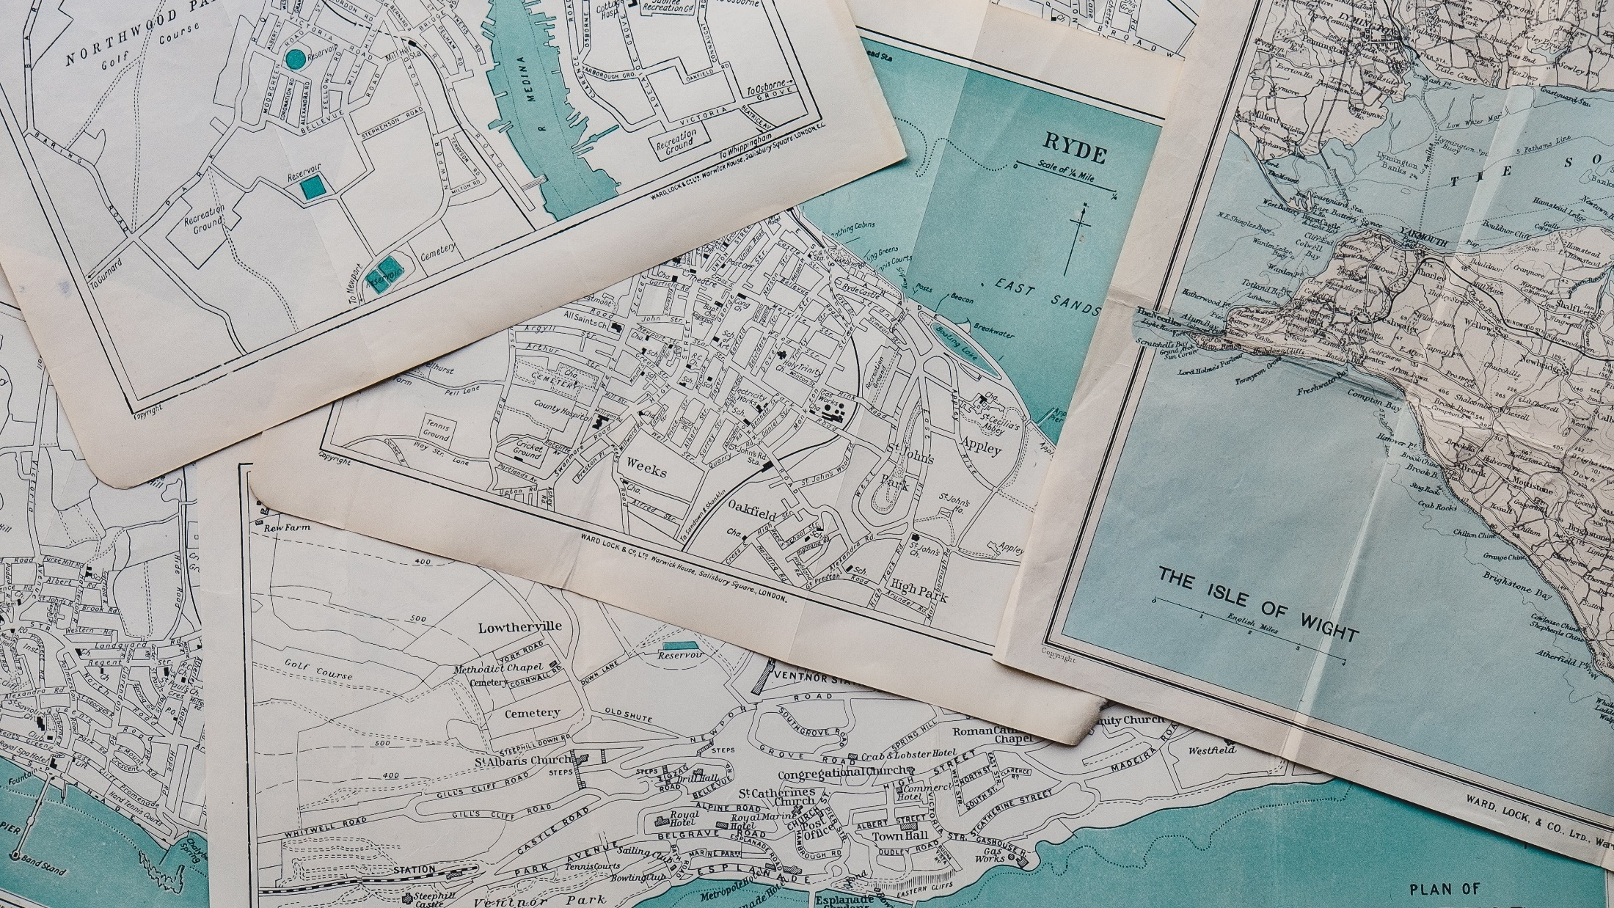
Foundations: Good map design concepts

Slide 19
Activity 1 Making a basic map
Making a basic map with ABS Statistical Area level 2s (SA2s) using:
ggplot2
leaflet for interactive maps
Activity 1 Making a basic map
Notes:
Interactive maps for web, which we will show how to export later in the presentation.

Slide 20
Activity 1 Making a basic map
1a. ggplot2:
Load packages – raster, leaflet, sf, readxl, tidyverse
Read in shapefile Simple SA2.shp using read_sf and examine the data
Change SA2_MAIN16 variable to numeric using as.numeric
Plot using ggplot2 and geom_sf
Activity 1 Making a basic map
Notes:
Bonus content: removing background axis, labels and grid.

Slide 21
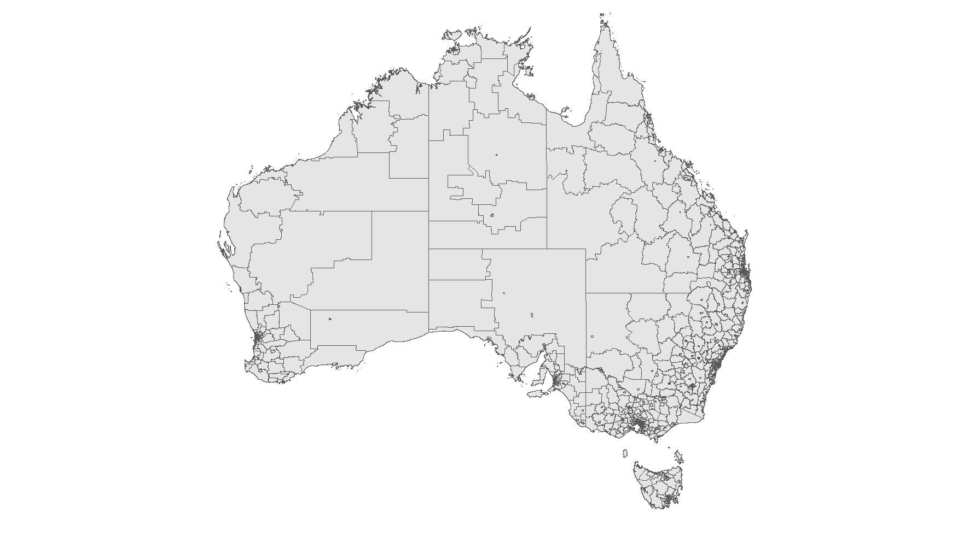
Activity 1a result A basic map with SA2 boundaries
Activity 1 Making a basic map

Slide 22
Activity 1b,c Making a basic interactive map
1b. Leaflet:
Using simple features data from previous exercise, make an interactive map using leaflet.
1c. Differencing shapes to remove Christmas and Cocos islands
Create lat long of map boundaries [rbind]
Convert to simple features polygon [st_polygon]
Trim shape file [st_intersection] and re-plot in leaflet
Activity 1 Making a basic map
Notes:
Leaflet is an open-source JavaScript library for interactive maps.
Add layers (i.e., features) to the map by using layer functions (e.g. addTiles, addMarkers, addPolygons) to modify the map.
Here, we’re using the default base map - OpenStreetMap tiles. Tile maps are maps displayed in a browser by seamlessly joining dozens of individually requested image or vector data files over the internet.
We’re then adding polygons – in this case, the SA2s.
CRS:
Geographic files have a CRS - but it's not always defined
Usually the spatial file has metadata that tells you the CRS.
We can use st_crs to retrieve CRS from simple features object
Currently aus_box is a numeric vector. We need the 2 objects to be able to talk to each other. So we need to have them as sf objects
st_polygon requires x argument to be a list with numeric matrices.
St_sf requires a simple features list column to be converted to an sf object.
st_intersection finds the intersection between two sets of geometries.

Slide 23
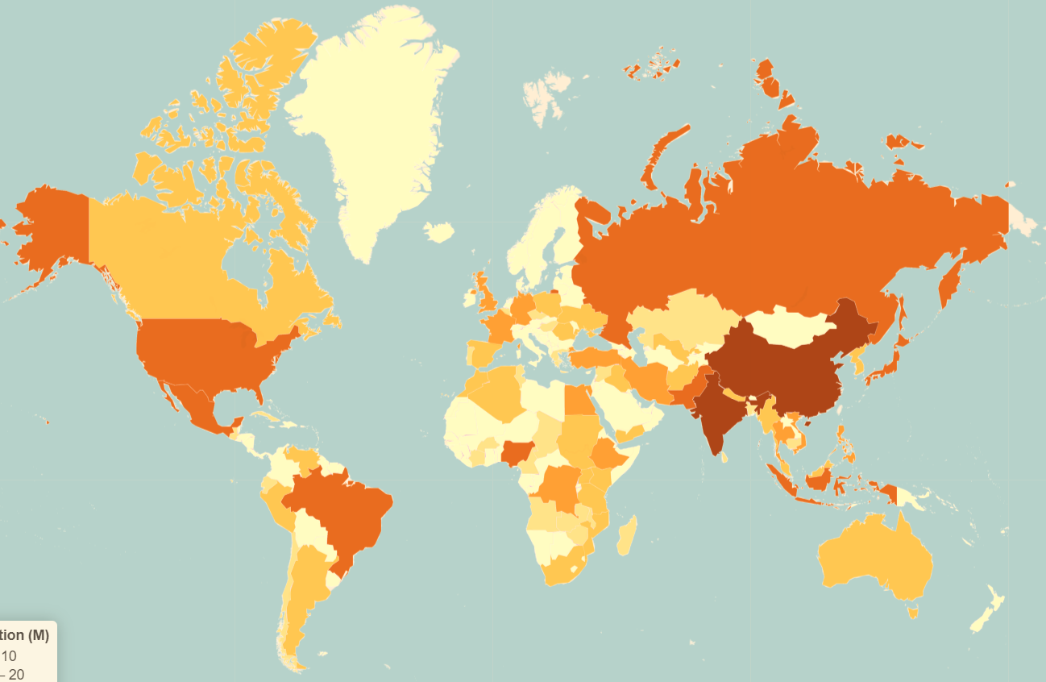
Choropleths
Notes:
A choropleth map is a thematic map in which geographical areas are coloured, shaded or patterned in relation to a data variable (such as population density or per capita income). This shows variations or patterns across locations.

Slide 24
Activity 2 Making a choropleth
Charting Socio-Economic Indexes for Areas (SEIFA) scores for Index of Relative Socio-economic Disadvantage (IRSD) by geography.
Merge IRSD with geography (SA2s):
Read in IRSD data
Harmonise identifiers and values
Merge with statistical areas (SA2s) from Activity 1
Activity 2 Making a choropleth
Notes:
Low score = greater disadvantage, high score = lower disadvantage.

Slide 25
Activity 2 Making a choropleth
Merging Index of Relative Socio-economic Disadvantage (IRSD) data with geography
Read in IRSD data using read_excel
Harmonise identifiers with SA2 data (a vector)
Merge with statistical areas (SA2s) from Activity 1 [left_join]
Plot using leaflet and ggplot2
Activity 2 Making a choropleth
Notes:
left_join will join 2 tables by a common attribute. If NULL, it will do a natural join, using all variables with common names across the two tables.
colorFactor
Domain: The possible values that can be mapped. colorFactor needs categorical (factor) data. Here, that is Decile.
Leaflet
Weight = stroke width in pixels

Slide 26
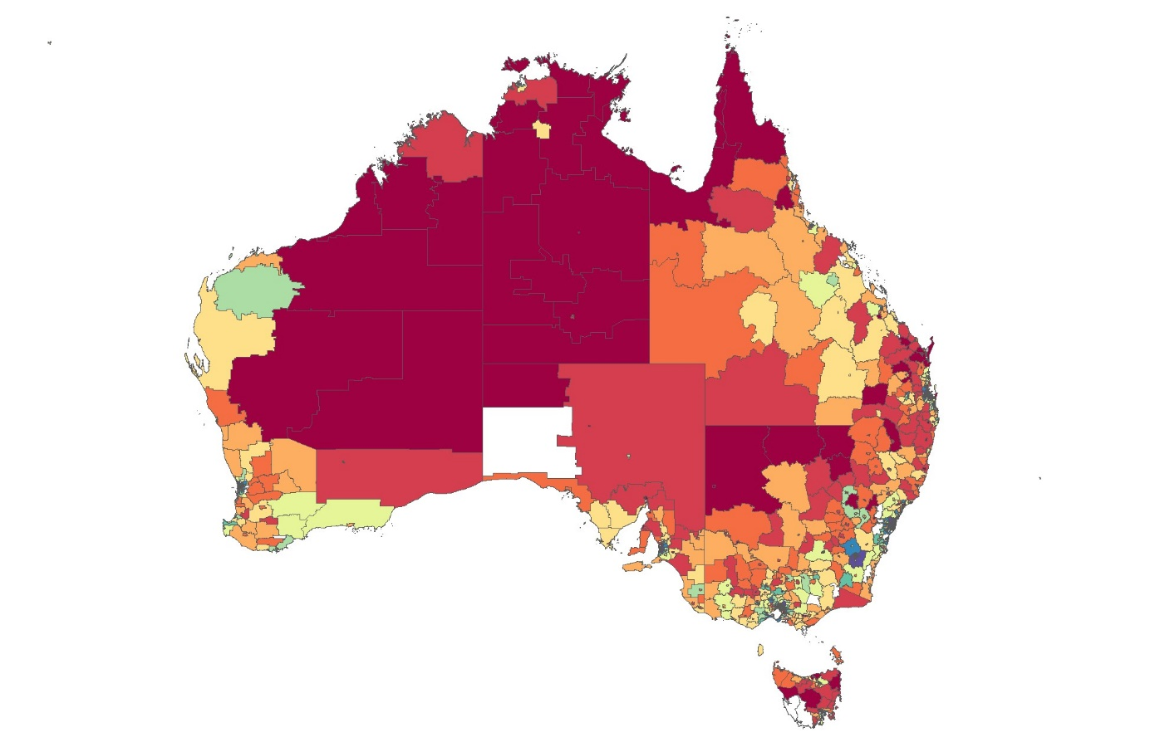
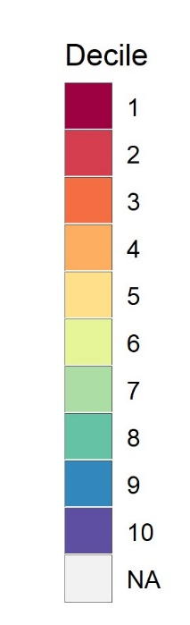
Activity 2 result Relative Socio-economic Disadvantage scores by SA2
Activity 2 Making a choropleth
Notes:
Low score = greater disadvantage, high score = lower disadvantage.

Slide 27
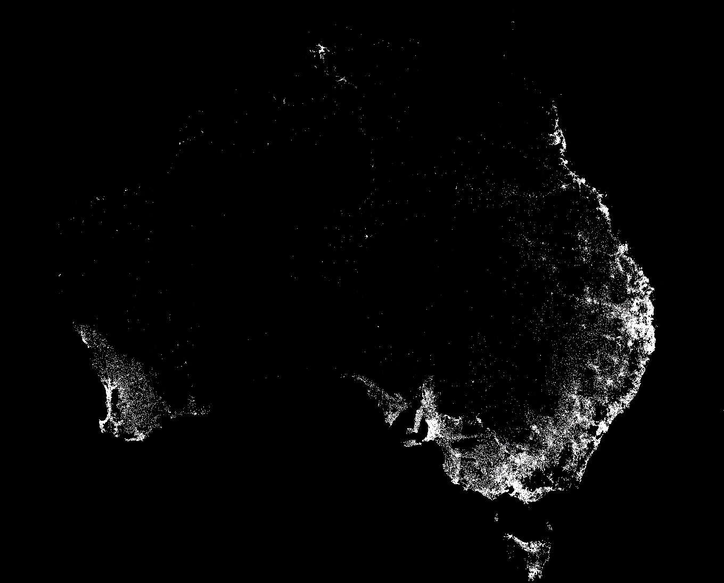
Representing population

Slide 28
Activity 3 Representing population
Right map for the right data
Plot based on key population centres
Clean Australian population grid data
Join lat/long population centres to statistical areas
Plot using ggplot2
Activity 3 Representing population

Slide 29
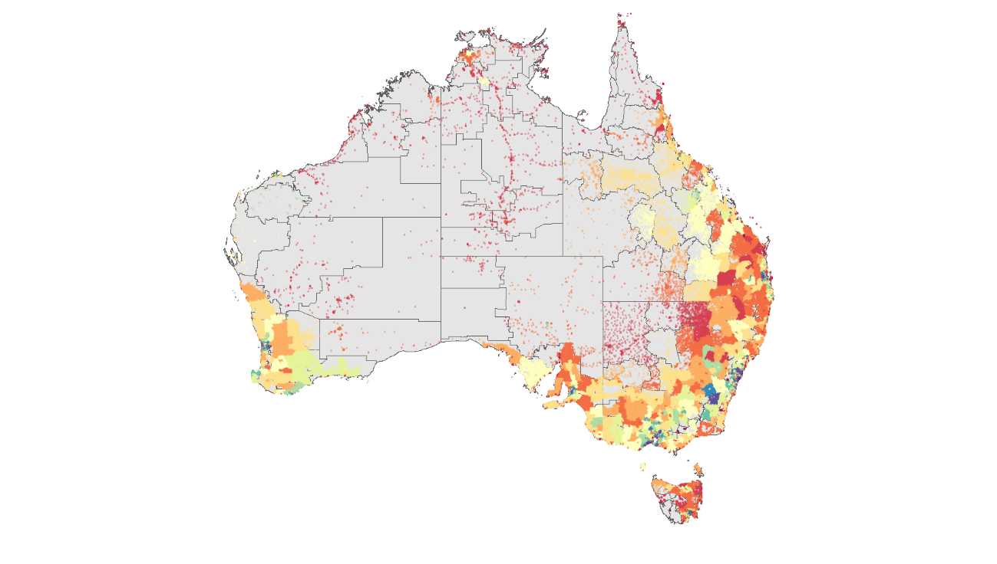
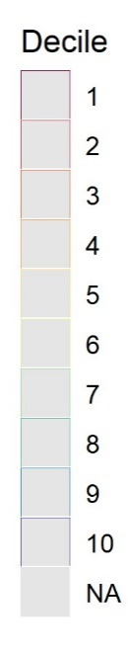
Activity 3 result Representing population
Quintile 5
Quintile 4
Quintile 3
Quintile 2
Quintile 1
Activity 3 Representing population
Notes:
Possible to convert population grid data (lat/ longs) to SA1 level… regional remoteness areas etc

Slide 30

Communication:
maps for print or web

Slide 31
Activity 4 Maps for print or web
Reports with ggplot (png/svg)
Web with leaflet (html/javascript)
Activity 4 Communication

Slide 32
Activity 4 Maps for print or web
Need to simplify data for web
rmapshaper makes data manageable
Activity 4 Communication

Slide 33
Activity 4 Maps for print or web
Use ggsave for reports
Use saveWidget for web
Activity 4 Communication

Slide 34

Key takeaways
Maps should match data - population grid better for socio-economic data
Quick publishable maps with R
3.
Key takeaways

Slide 35




Key takeaways

Slide 36
Bonus content
Geocoding
ABS concordances
Other types of maps
Bonus content

Slide 37
Bonus content Geocoding
lon lat
<dbl> <dbl>
1 151. -33.8
42 Wallaby Way,
Sydney
Convert messy geographic information to lon/lat
https://cloud.google.com/maps-platform/
Bonus content

Slide 38
Bonus content Geocoding
Register for a google API key (requires credit card but free)
Tell R your key with ggmap::register_google()
Let google deal with your horrible address/town data using ggmaps::geocode()
Bonus content

Slide 39
Bonus content Correspondences
Local government areas Postcodes Suburbs | Indigenous regions Remoteness areas Electoral division
Bonus content

Slide 40
Bonus content Correspondences
From geography
CG_SA2_2016_RA_2016.xlsx
To geography
All correspondences on data.gov.au
(Seach for ASGS 2016)
Bonus content

Slide 41
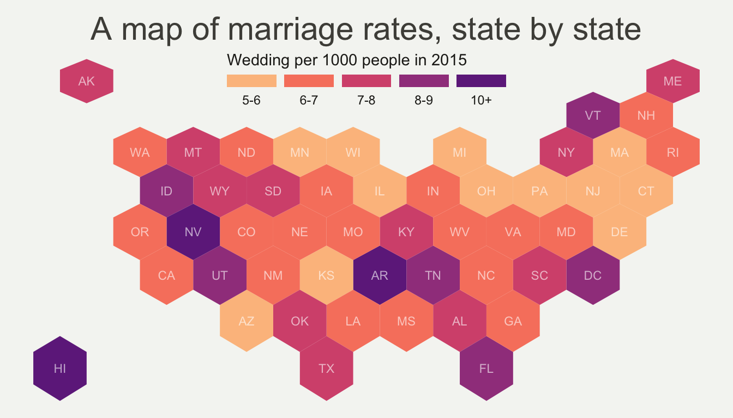
Bonus content Other maps
Tilegram / Hexbin map
Bonus content

